Slide 1
!!!!!!!!!!!!!!!!!!!!!!!!!!!!!!!!!!!!!!!!!!!!!!!!!!!!!!!! !Please use the iMac during the Lab course! !Please make sure the iMac is on before class! !!!!!!!!!!!!!!!!!!!!!!!!!!!!!!!!!!!!!!!!!!!!!!!!!!!!!!!!

Slide 2
Tutorial 5 Lab 1
cs3402

Slide 3
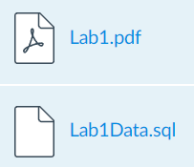
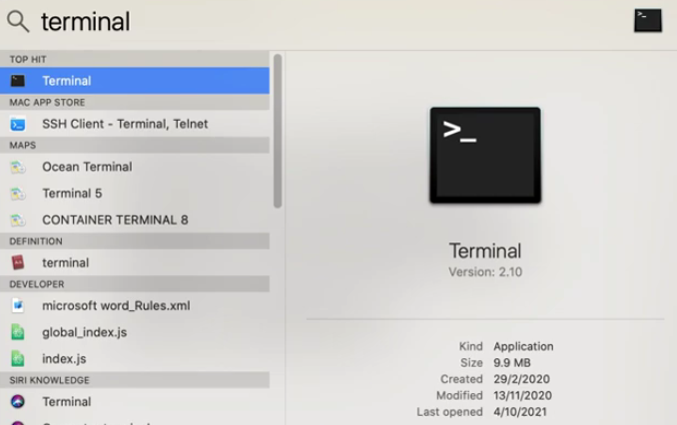
Preparation
Download from Canvas:
Terminal:
command + space
Input ‘terminal’
Zoom in: (command + ’+’)

Slide 4
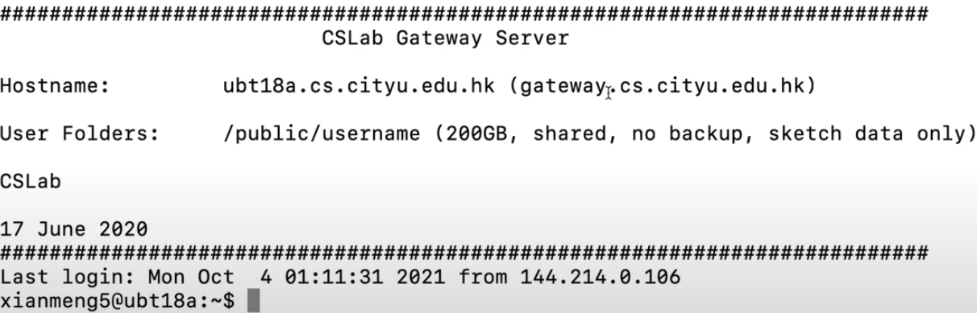
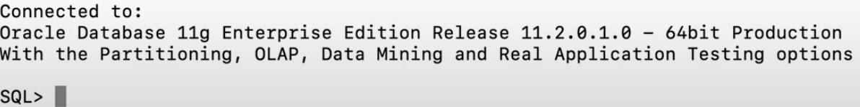
Oracle accounts and System Login via MacOS
Terminal: ssh to gateway.cs.cityu.edu.hk
ssh your-e-id@ gateway.cs.cityu.edu.hk
yes
your e-id passwd or your wifi passwd
sqlplus
username: e-id
password: student-id (some digits)
Notes:
shuquanye2/Ye123456
Every one is okey?

Slide 5
Oracle accounts and System Login via MacOS
exit/quit
Want to use arrow keys?
help

Slide 6
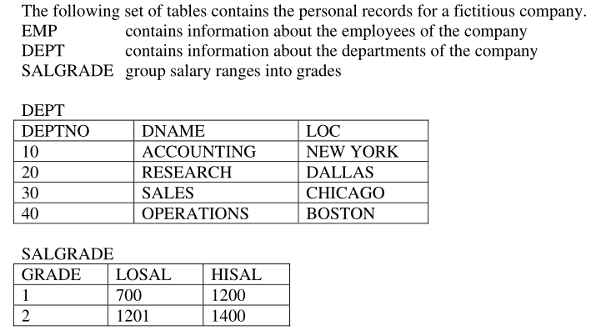
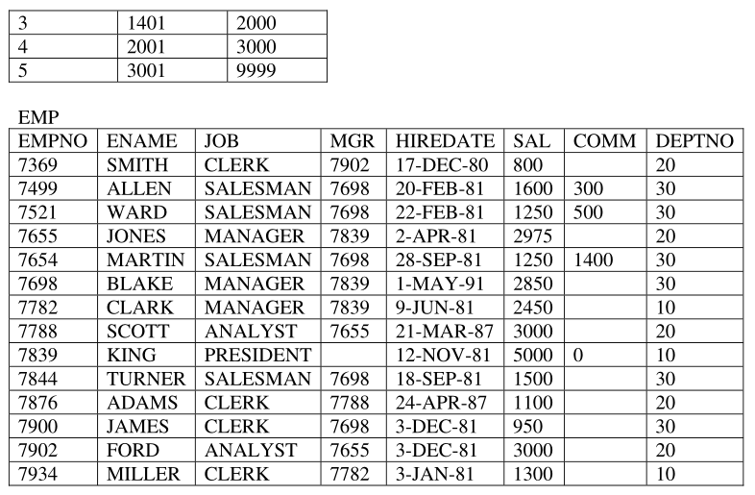
BASIC CONCEPT ON RELATIONAL DATABASE
Notes:
We can start with 4. BASIC CONCEPT ON RELATIONAL DATABASE in lab1.pdf
Here we need you to create a table first, but it will be time consuming if you insert one by one.

Slide 7
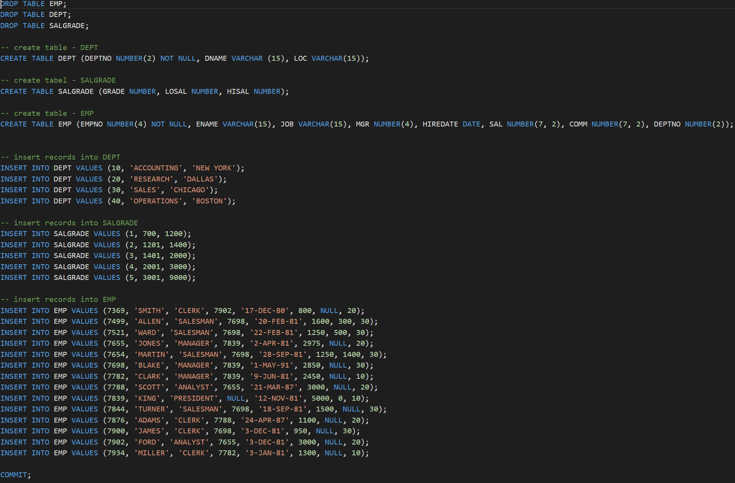
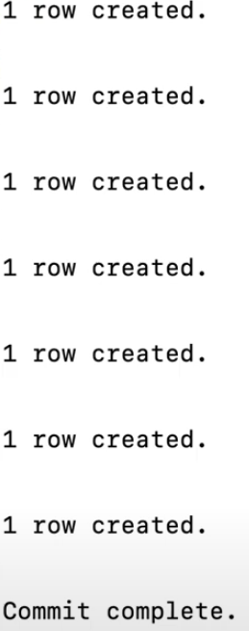
BASIC CONCEPT ON RELATIONAL DATABASE
Create table?
Notes:
Lab1Data.sql
I have already uploaded for you

Slide 8
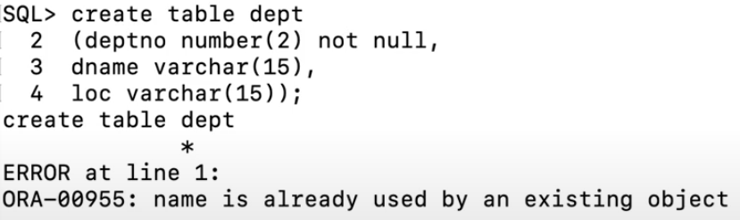

BASIC CONCEPT ON RELATIONAL DATABASE
Drop table?
Notes:
The table dept already exist
Try the commands in lab1.pdf and get familiar with them

